Slide 1
8086 - Flag, Minimum Maximum Mode

Slide 2








MEET OUR GROUP
Mim Akter
222002104
Md. Al Mamud
Mr. Mozdaher Abdul Quader
Dept of CSE
Green university of Bangladesh.
222002106
Md. Shoayeb Hossain
222002105

Slide 3
Table of contents
01
02
03
04
Flag Register
Minimum Mode
Details about 8086 flag register pin.
Details about 8086 Minimum mod pin.
Maximum Mode
Conclusion
Details about 8086 Maximum mod pin.
Conclued about our presentation.

Slide 4
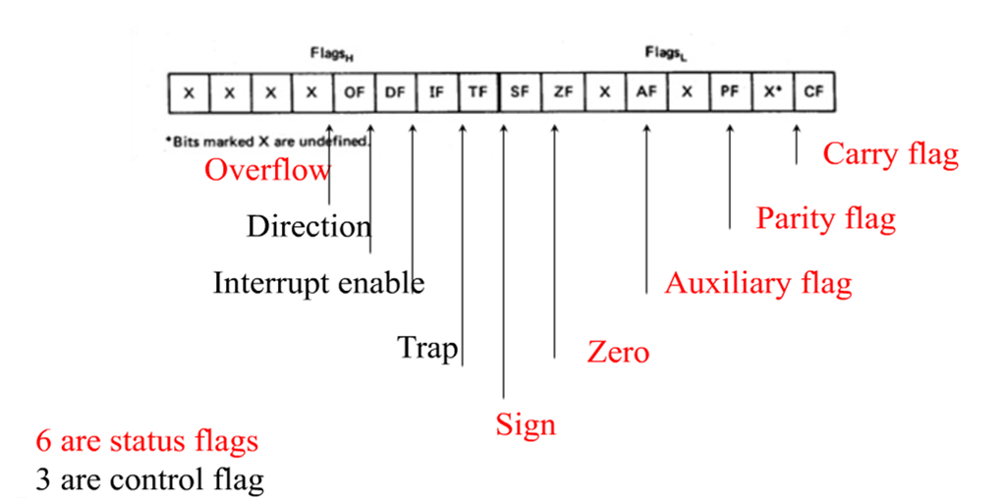
Flags

Slide 5
Status Flag
01
02
03
Sign Flag (S)
Zero Flag (Z)
Auxiliary Carry Flag (AC)
04
05
06
Parity Flag (P)
Carry Flag (CY)
Overflow Flag (O)
MSB indicate the sign bit.
Tells us whether or not our answer has been zeroed.
Indicates a carry between bits 3 and 4 during mathematics operations.
In the result of an arithmetic or logical operation is even or odd.
Shows whether there was a carry on the(MSB) during mathematics operations.
This bit is raised when the result of a signed operation goes beyond limits of the data type.

Slide 6
Control Flags
Direction Flag (DF)
Trap Flag (TF)
Flags
Interrupt Flag (IF)
If DF=1, the string instruction will automatically decrement the pointer. If DF=0,the string instruction will automatically increment the pointer.
Decides on the direction of string operations, it can vary from forwards to backwards.
If TF=1, the CPU automatically generates an internal interrupt after each instruction, allowing a program to be inspected as it executes instruction by instruction.
May help in debugging one instruction at a time by turning on single step mode.
If IF=1, the CPU will recognize external interrupt request (Interrupt Disabled). If IF=0, then interrupt disabled.
That can turn ON or OFF maskable interrupts.

Slide 7
02
Minimum Mode

Slide 8
Minimum Mode
Overview
Operates when MN/MX’ = 1.
Only processor in the system which provides all the control signals.
The circuit is simple but it does not support multiprocessing.
Transceivers, latches, 8284 clock generator, 74138 decoder, memory and i/o device.
The address bus of 8086 is 20 bits long.

Slide 9
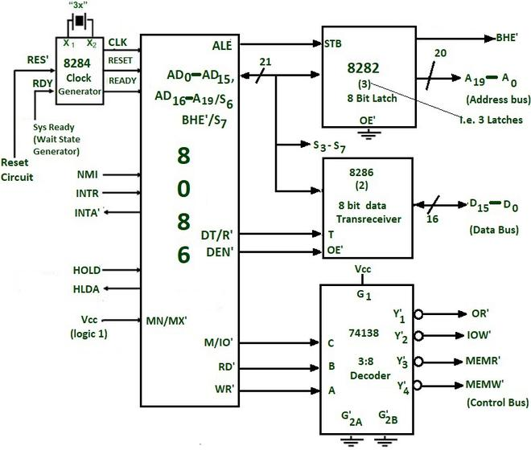
Minimum Mode
Circuit
Control signals provided by 8086 for memory operations and i/o interfacing :
They are used to identifying whether the bus is carrying a valid address or not , in which direction data is needed to be transferred over the bus, when there is valid write data on the data bus and when to put read data on the system bus.

Slide 10
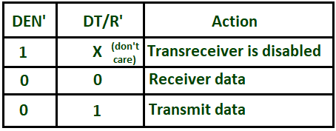
Minimum Mode
8286 (8 bits) transceivers
They are bidirectional buffers and also known as data amplifiers.

Slide 11
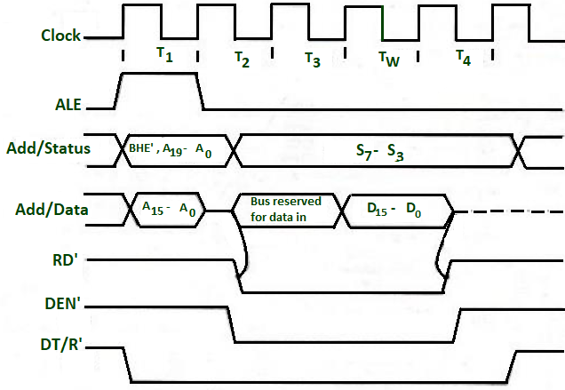
Minimum Mode
Timing diagram
The working of min mode can be easily understood by timing diagrams.

Slide 12
03
— Maximum Mode —

Slide 13
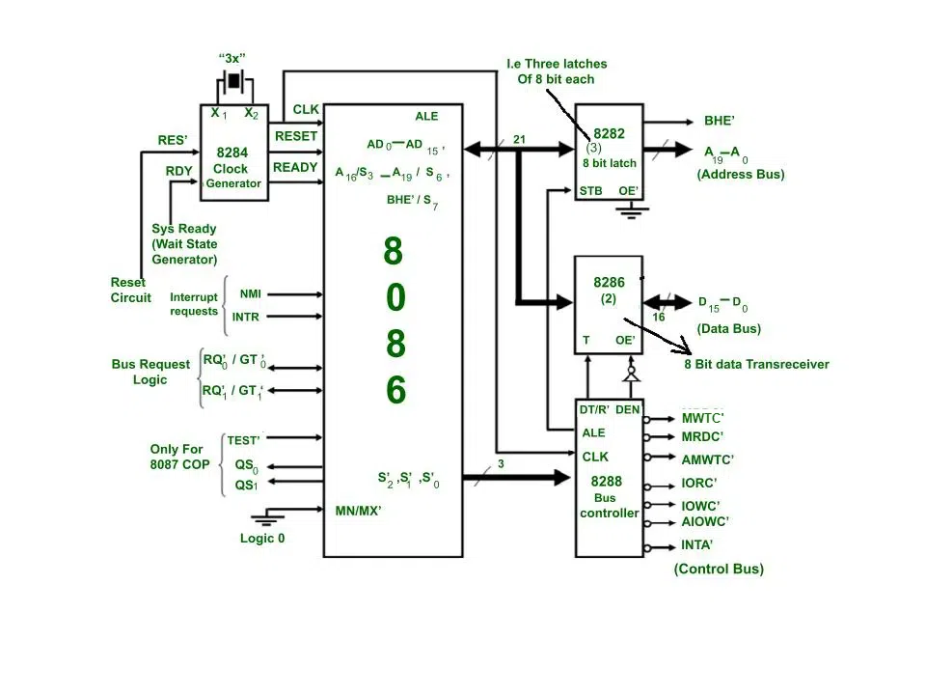

Slide 14
— Maximum Mode —
The transceivers are enabled the DEN signal.
The direction of data is controlled by the DT/R signal.
DEN is connected to OE' and DT/R' is connected to T. Both DEN and DT/ R' are given by 8288 bus controller.

Slide 15
— Real-World Examples —
Minimum Mode
Home appliances, calculators.
Maximum Mode
Cloud servers, data centers.

Slide 16
— Comparison of Minimum and Maximum Modes —
Feature | Feature | Feature
Configuration | Single-processor | Multiprocessor
MN/MX# Pin Setting | Logic '1' | Logic ‘0'
Control Signals | Internal | External

Slide 17
— Conclusion —
The 8086’s Minimum and Maximum Modes demonstrate its versatility, allowing it to adapt to a wide range of system requirements. Understanding these modes is essential for designing efficient computing systems.

Slide 18


Thanks!
Do you have any questions?

